Slide 1
Our toolbox

Slide 2
Recap
Decent summaries of Bayesian vs frequentist (likelihood / ‘maximum likelihood’) estimation:
https://www.youtube.com/watch?v=0LQmZXCWMFI
https://www.psychologicalscience.org/observer/bayes-for-beginners-probability-and-likelihood

Slide 3
The tools
Having great tools and using them is half the battle
Don’t be afraid to ask for help, or offer it
Software Carpentry & Data Carpentry
Keep attending industry / academic meetups, seminars and hackathons
Become multilingual but don’t lose old skills
Be organised.

Slide 4
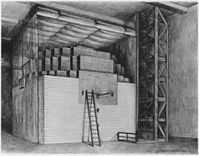
Fermi estimation
Order-of-magnitude (10^{n}) calculations can get you a long way!
Also good for wrapping your mind around problems, which in turn will help you design experiments and sanity-check results

Slide 5
Big power
Effect size = 𝛍 - 𝛍₀ (difference from null)
Many of the effect sizes we might want to detect are incredibly small.
So we need big samples:
Effect size (𝛍-𝛍₀): | +1.0 | +0.1 | +0.01
Detect with ANOVA at: | Expected N: | N | N
𝛂 = 0.05, 𝛃 =0.5 | 17 | 1,570 | 156,978
𝛂 = 0.01, 𝛃 =0.5 | 25 | 2,336 | 233,580
𝛂 = 0.001, 𝛃 =0.5 | 37 | 3,415 | 341,499
See e.g.
http://www.sample-size.net/sample-size-means/
http://www.bristol.ac.uk/caite/geocode/newcastleshortcourse/powerandsamplesize.pdf

Slide 6

Formats
Get used to dealing with zillions of formats, and converting between them
D-R-Y still applies, so look for libraries to help you first – but always check the output(!)
When writing research data yourself, consider the person coming after you…

Slide 7
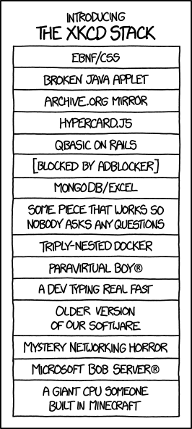
Notes, comments and metadata
Record everything if you ever want to repeat it.
Casual notebooks (Evernote, Notes etc) all useful
Metadata, parameters and versions for analyses
Good lab-book as important as wet science
Ever more tools appearing to help track analyses (iPython, R notebooks, etc)
Code needs to be well commented, well named, and well designed
(GOD objects)

Slide 8
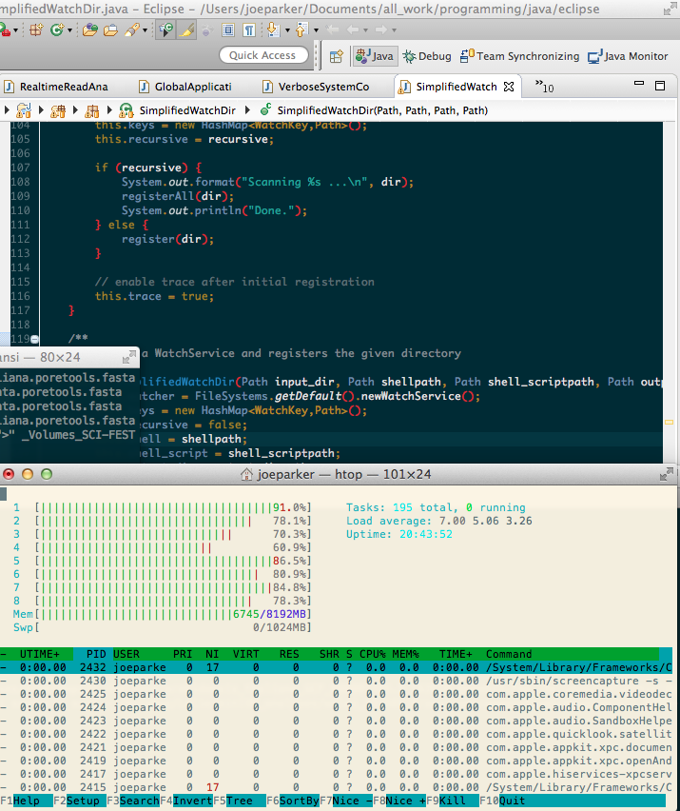
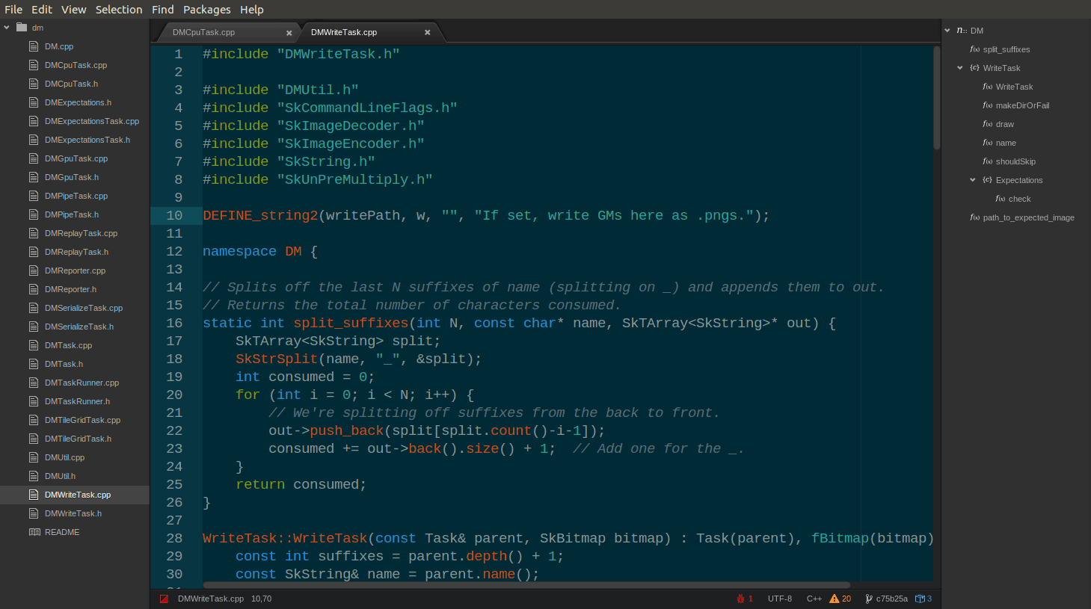
IDEs
Integrated development environment – anything that makes it easier to organise, import, write, test, build and publish code.
Full IDEs:
Eclipse (mainly Java)
Xcode (iOS, C)
Rstudio
High-powered text editors:
Atom
TextWrangler

Slide 9
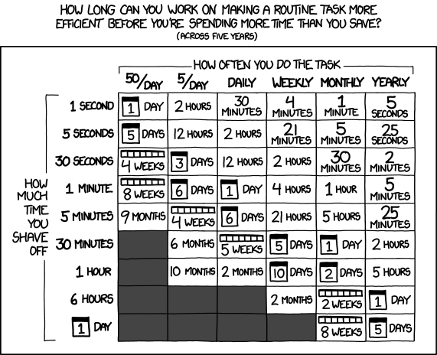
Code optimisation…

Slide 10
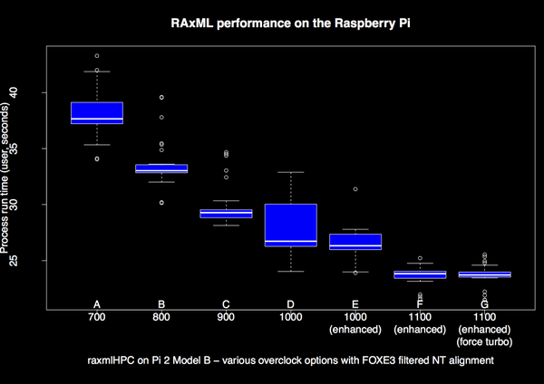
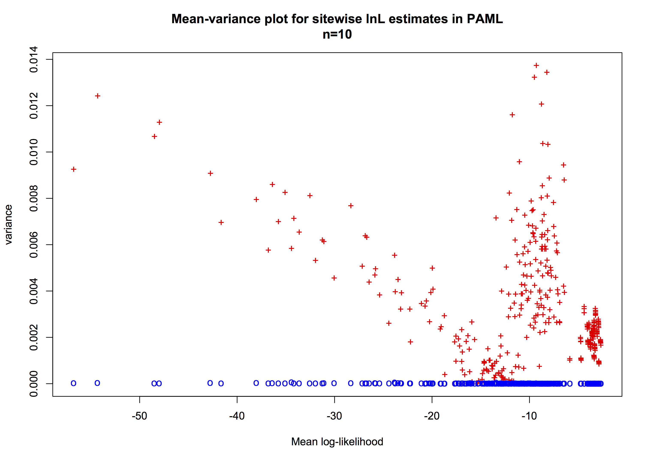
Benchmarking
Analyse execution times and system usage:
Which steps are taking the most time/RAM?
Has the performance improved? Worsened?
HOW MUCH MORE $£€ do we need…
Measurements aren’t precise, just so happens to be a… statistical problem(!)

Slide 11
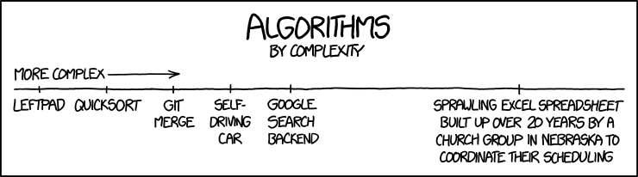
Algorithm complexity
We have a model with N parameters: How long will it take? And if N+1? N+m?
Algorithmic complexity attempts to analyse the likely best- worst- and average-case execution time as a function of problem size
Simple for simple algorithms, e.g.
Less so for complex ones
An apparently slower method may have better complexity implications than faster, more complex one.
Method | Best | Worst
Quick sort | O(n log n) | O(n²)
Bubble sort | O(n) | O(n²)
Merge sort | O(n log n) | O(n log n)

Slide 12
Parallelisation
“for (n in 1:lots)”
Parallelisation is an obvious way to speed up / power up analyses
Not all parallelisations are the same
Main types:
Array jobs
Highly parallel/distributed jobs (MPI)

Slide 13
Array jobs
We have multiple replicates / subsets
Each is effectively independent – but we have a lot of them to get through
Analyse separately, together, or sequentially
Synchronisation irrelevant
“I could run each of these on my personal machine, but it takes ages”
e.g. BLAST metagenomes; parameter sweeps
Optimisation is easy; optimise each replicate and scale

Slide 14
Highly parallel / MPI jobs
A very large dataset, but our inference depends on all of the information
We can/need to split the algorithm across several / 000s of cores
Working simultaneously – synchronisation issues relevant
MPI (message passing interface) / OpenMPI
Latency (network speeds) between node and disk / each other
e.g. particle simulations; interactome modelling
Optimisation is much harder

Slide 15
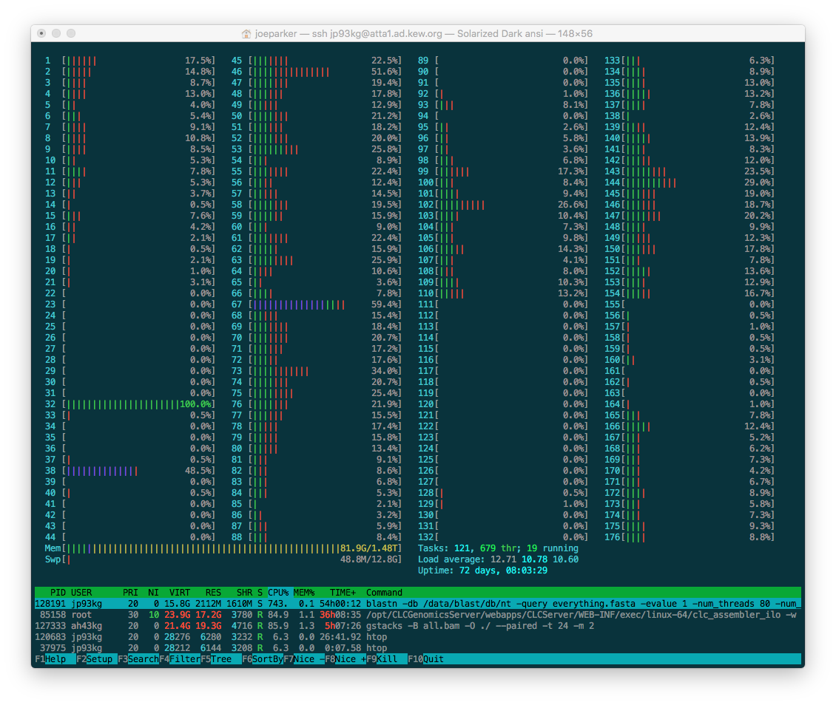
HPC vs HTC
HPC: High performance computing
HTC: High throughput computing

Slide 16
HPC vs HTC
HPC: High performance computing:
Fast cores and interconnects for MPI
Lots of RAM
Problems with significant memory footprint
e.g. de novo genome assemblies, protein folding
Each job a significant share of total capacity

Slide 17
HPC vs HTC
HTC: High throughput computing:
Lots and lots (>000s) of cores
RAM per core more limited
Highly parallel / long job time / speed unimportant
e.g. public BLAST server, gene annotation, phylogenomics
Very large number of cores means capacity for multiple tasks at once

Slide 18
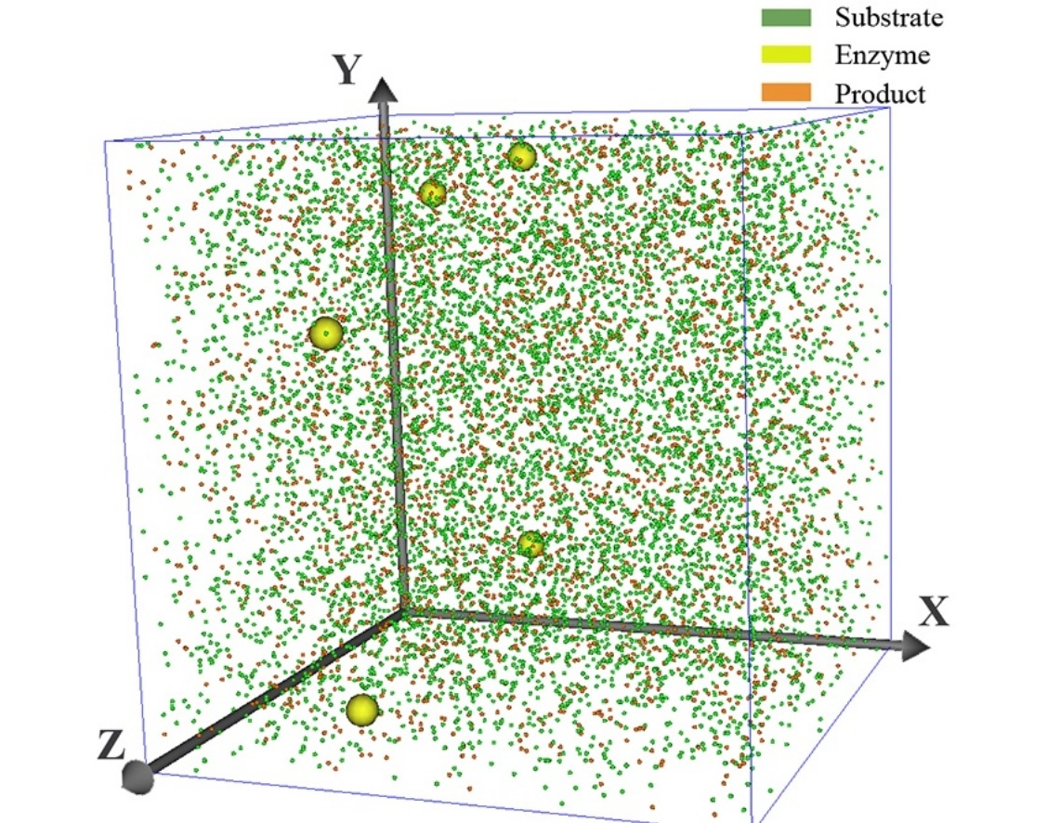
GPUs and MCMC/agent-based modelling
Certain types of computation require so many parallel but low-level calculations they benefit from quite different architecture
This can be run effectively on GPUs with some optimisation and libraries e.g. BEAGLE
e.g. swarming algorithms; agent-based simulation; coalescent phylogenomics; basecalling / HMMs

Slide 19

Cloud
It doesn’t really matter where our machines are
At the extreme end we can use cloud computing
Rented, temporary time on remote computer
Private (Amazon AWS; Google) and public (ResearchCloud) providers
Usage normally paid per-unit time
Can improve portability
Costs need to be controlled carefully
Still has a CO₂ footprint(!)

Slide 20


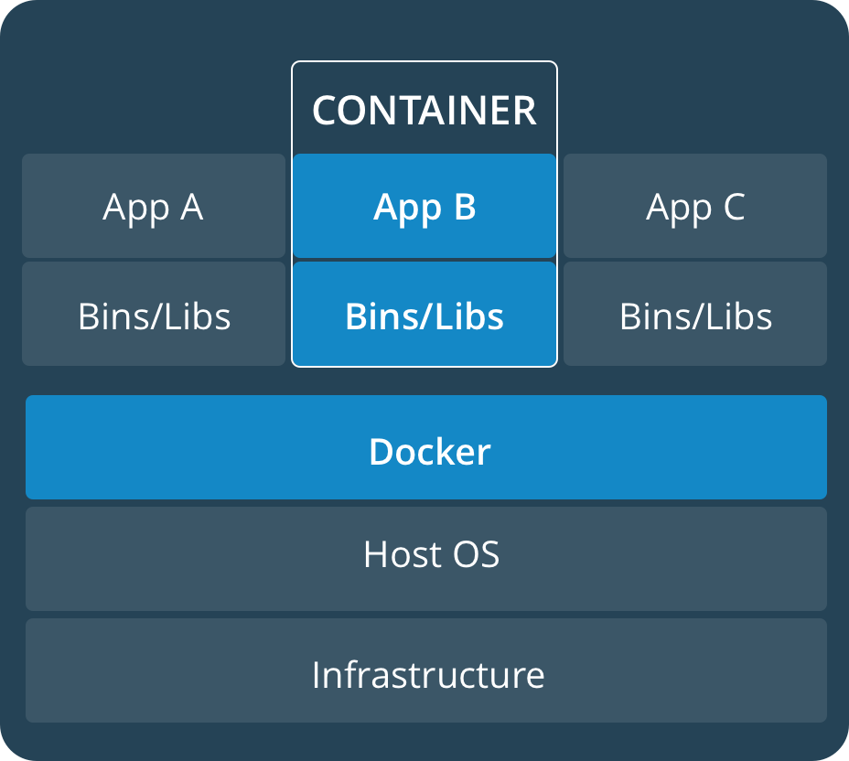
Docker and VMs
VMs (virtual machines) provide a means to ensure the computing environment is replicable.
Also enhances portability
VM + something to run on it = container
Docker and Singularity are just systems for creating, sharing and running containers

Slide 21
Docker and VMs
Containers usually contain:
environment setup and dependencies
script(s) to ingest, analyse and report results
But usually don’t contain the research data itself.
Data normally read/written from attached volumes
Containers are frequently used to scale up analyses, e.g.
My Great Pipeline
Containerise: MyGreatContainer
Replicate:
MyGreatContainer(dataset_01);
MyGreatContainer(dataset_02);
MyGreatContainer(dataset_03);

Slide 22
Automated testing / integration
Build testing and integration commonly used in enterprise computing to ensure build quality, and flag up bugs as they arrive:
Commit change → Build → test → Integrate passing builds to production code
Tests fired automatically whenever changes made
Changes (so improvements) can be made continuously (‘continuous integration’)
Requires the existence of test methods and data, written early to be effective
Continuous analysis is an emerging idea in bioinformatics, mirroring this philosophy

Slide 23
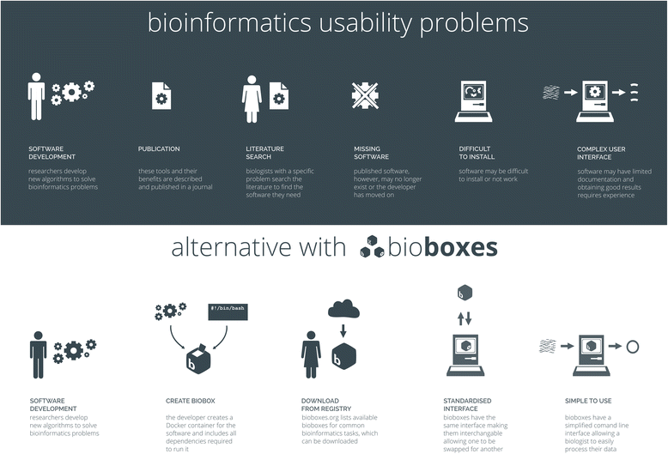
Bioboxes
Effectively a wrapper for containerised Docker pipeline

Slide 24
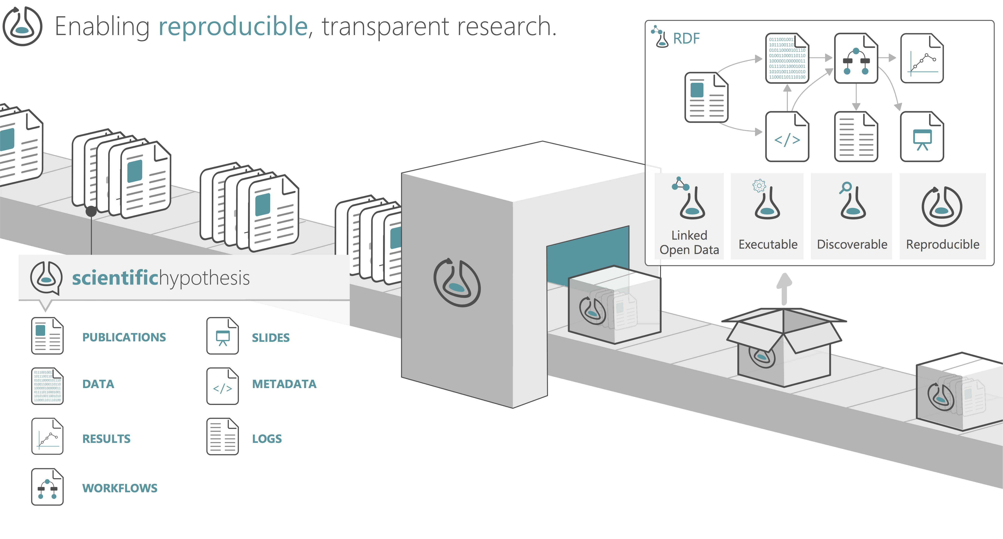
ResearchObject
Integrated data import / analysis / report generation: relatively new but something like this will take off soon…

